Slide 1
Technology
Pathway
Permanence
Atmosphäre
Crops (e.g. perennial)
Concetrated CO₂
Saline Aquifer
BECCS
>1000 yrs
Atmosphäre
Baüme
10-100 yrs
Aufforstung
Luftfilter
-Anlagen
Atmosphäre
Concetrated CO₂
Saline Aquifer
>1000 yrs
Luftfilter
-Anlagen
Atmosphäre
Concetrated CO₂
Synfuel
Atmosphäre
0 yrs
Ozean-
Alkalisierung
Atmosphäre
Hydrosphäre
??
Atmosphäre
Biosphäre
Produktsphäre
Lithosphäre
Hydrosphäre

Slide 2
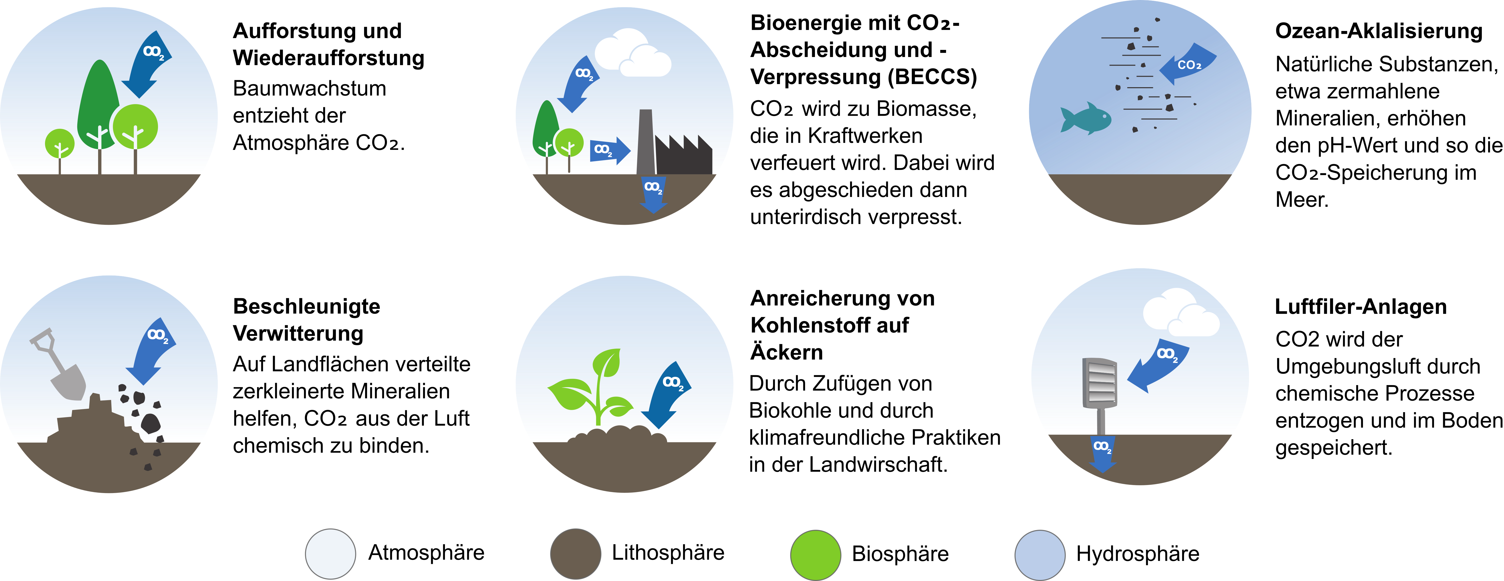

Slide 3

Defining CDR pathways
ATMOSPHERE
CDR methods can be mapped as pathways through these pools:
BIOSPHERE
PRODUCTS
HYDRO-SPHERE
Perennial
crops
T
P
Fuels
P
Perennial crops for CCS (demo)
Agri & forest residues
Chemicals
Dissolved CO₂
Trees
Aggregates
Conc. CO₂
Bicarbonate
Wetlands
Wood in construction
Captured CO₂ to geological storage
Biochar
T
Soils
LITHOSPHERE
Depleted fossil fuel reservoirs
Saline aquifers
Minerals

Slide 4
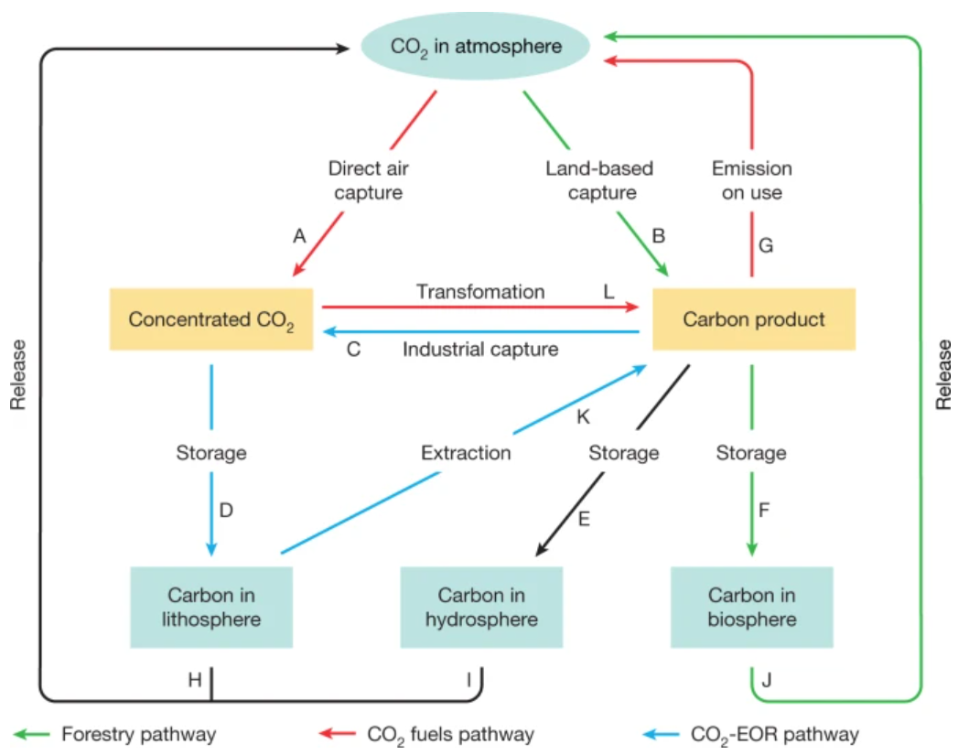
Carbon Dioxide Removal (CDR)
CDR covers a range of approaches, all with the shared property of being human interventions to take CO₂ out of the atmosphere and store it durably.
There are number of ways to capture the CO₂ from the air, a number of conversion pathways through which the captured carbon can be modified, and a number of different sinks for storage.
CDR often share the same elements of capture, conversion and storage – with other CDRs and with emission reduction methods.
Rather than thinking of these as separate, independent approaches, it helps therefore to consider CDR as interlinked in the carbon cycle…
Source: Hepburn et al., 2019. Nature, 575(7781), 87–97.
https://doi.org/10.1038/s41586-019-1681-6

Slide 5
Defining CDR pathways
ATMOSPHERE
Within each category there are carbon pools with different capacities, accumulation rates, storage permanence (see later), co-benefits, etc.
BIOSPHERE
PRODUCTS
HYDRO-SPHERE
Perennial
crops
Fuels
Agri & forest residues
Chemicals
Dissolved CO₂
Trees
Aggregates
Conc. CO₂
Bicarbonate
Wetlands
Wood in construction
Captured CO₂ to geological storage
Soils
Biochar
LITHOSPHERE
Depleted fossil fuel reservoirs
Saline aquifers
Minerals

Slide 6
Defining CDR pathways
ATMOSPHERE
CDR methods can be mapped as pathways through these pools:
BIOSPHERE
PRODUCTS
HYDRO-SPHERE
Perennial
crops
Fuels
Tree planting
(demo)
Agri & forest residues
Chemicals
Dissolved CO₂
Trees
Aggregates
Conc. CO₂
Bicarbonate
Wetlands
Wood in construction
Captured CO₂ to geological storage
Soils
Biochar
LITHOSPHERE
Depleted fossil fuel reservoirs
Saline aquifers
Minerals

Slide 7
Defining CDR pathways
ATMOSPHERE
CDR methods can be mapped as pathways through these pools:
BIOSPHERE
PRODUCTS
HYDRO-SPHERE
Perennial
crops
Fuels
Enhanced peat uptake (demo)
Agri & forest residues
Chemicals
Dissolved CO₂
Trees
Aggregates
Conc. CO₂
Bicarbonate
Wetlands
Wood in construction
Captured CO₂ to geological storage
Soils
Biochar
LITHOSPHERE
Depleted fossil fuel reservoirs
Saline aquifers
Minerals

Slide 8
Defining CDR pathways
ATMOSPHERE
CDR methods can be mapped as pathways through these pools:
BIOSPHERE
PRODUCTS
HYDRO-SPHERE
Perennial
crops
T
P
Fuels
Biochar
(demo)
Agri & forest residues
Chemicals
Dissolved CO₂
T
P
Trees
Aggregates
Conc. CO₂
Bicarbonate
Wetlands
Wood in construction
Captured CO₂ to geological storage
Soils
Biochar
LITHOSPHERE
Depleted fossil fuel reservoirs
Saline aquifers
Minerals

Slide 9
Defining CDR pathways
ATMOSPHERE
CDR methods can be mapped as pathways through these pools:
BIOSPHERE
PRODUCTS
HYDRO-SPHERE
Perennial
crops
Fuels
Enhanced rock weathering (demo)
Agri & forest residues
Chemicals
Dissolved CO₂
Trees
Aggregates
Conc. CO₂
Bicarbonate
Wetlands
Wood in construction
Captured CO₂ to geological storage
Soils
Biochar
LITHOSPHERE
Depleted fossil fuel reservoirs
Saline aquifers
Minerals

Slide 10
Defining CDR pathways
ATMOSPHERE
CDR methods can be mapped as pathways through these pools:
BIOSPHERE
PRODUCTS
HYDRO-SPHERE
Perennial
crops
Fuels
DACCS
(demo)
Agri & forest residues
Chemicals
Dissolved CO₂
Trees
Aggregates
Conc. CO₂
Bicarbonate
Wetlands
Wood in construction
Captured CO₂ to geological storage
Biochar
T
Soils
LITHOSPHERE
Depleted fossil fuel reservoirs
Saline aquifers
Minerals

Slide 11
Defining CDR pathways
ATMOSPHERE
Each carbon pool and each conversion step may involve transport and processing costs, inputs and outputs of energy and materials, and also GHG emission
These form our units for evaluation
BIOSPHERE
PRODUCTS
HYDRO-SPHERE
Perennial
crops
T
P
Fuels
Agri & forest residues
Chemicals
P
Dissolved CO₂
T
P
Trees
Aggregates
Conc. CO₂
Bicarbonate
Wetlands
Wood in construction
Captured CO₂ to geological storage
Biochar
T
Soils
LITHOSPHERE
Depleted fossil fuel reservoirs
Saline aquifers
Minerals

Slide 12
Defining CDR pathways
ATMOSPHERE
How permanent should it be?
Not the role of the evaluation framework to define a threshold (but a key question for the Hub!)
But permanence/stability will be a criterion – see later
Think we can agree <1yr is definitely out of scope
BIOSPHERE
PRODUCTS
HYDRO-SPHERE
2-5yr
Perennial
crops
<1yr
Fuels
Agri & forest residues
1-10yr
Chemicals
Dissolved CO₂
<1yr
Trees
1000yr+
Aggregates
Conc. CO₂
<1yr
Bicarbonate
>1000yr
10-100yr
Wetlands
Wood in construction
100-1000yr?
10-100yr?
Captured CO₂ to geological storage
1-10yr
Soils
1-100yr?
Biochar
LITHOSPHERE
Depleted fossil fuel reservoirs
Saline aquifers
Minerals
>1000yr

